Slide 1
Discover Cross-Modality Nuances for Visible-Infrared Person Re-Identification (MPANet, CVPR’21)
2023.5

Slide 2
Reference
Discover Cross-Modality Nuances for Visible-Infrared Person Re-Identification
https://paperswithcode.com/paper/discover-cross-modality-nuances-for-visible
Deep learning for visible-infrared cross-modality person re-identification: A comprehensive review
https://www.sciencedirect.com/science/article/abs/pii/S1566253522002007
Notes:
首先简单看一下对比学习领域DINO同时期或之前工作的经典方法，主要是这两个，因为simCLR结构比较经典，也比较简单，DINO的模型结构与BYOL相近，

Slide 3
Contents
VI-ReID
Discover Cross-Modality Nuances for Visible-Infrared Person Re-Identification
Notes:
大家好，今天给大家分享的方向是VI-ReID，也就是可见光-红外的跨模态场景下的行人再识别，分享的论文是MPANet，我们之前未涉及跨模态方面的ReID，因此今天的议程分为两部分，首先我带大家总结一下VI-ReID方向大概是在搞什么，然后再看一下今天的论文。

Slide 4
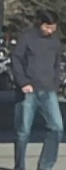


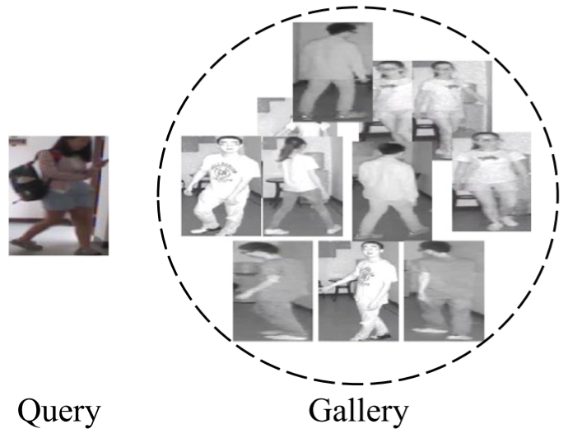
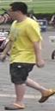
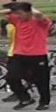

VI-ReID
Task
Visible-infrared(RGB-IR) cross-modality person ReID
In dark environments, IR images have more sufficient information but there is a modality gap between Visible-IR images
(MSMT17)
(Market1501)
Single visible modality ReID(VV-ReID)
cross-modality VI-ReID
（在需要24小时进行再识别的系统中，黑暗环境下使用红外（红外-可见光双摄）摄像头更合适，但我们需要缓解可见光-红外图像间的模态鸿沟）
Notes:
首先我们回顾一下常见的ReID公开数据集，比如MSMT17和Market1501，我们可以说其中大部分图像都是在白天，或者说光线比较充足的场景下采集的。然而如果在一台设备上进行不间断的再识别，那么在夜晚光线较暗时，可见光监控头成像可能整体都是暗的，采到的图像基本就不包含啥信息了。因此这时使用红外成像更加合适，比如最右边圆圈中这组图像就是近红外采集的，可见在低光照场景下，还是能从红外图像中分辨出行人与背景。再者，现在部分监控头是双摄的，也就是在检测到光照较暗时自动换用红外摄像头，像我们之前在燕电，大概在晚上六七点，一些摄像头就会采到近红外图像，而不再是彩色RGB图像了。所以说在ReID实际落地中，红外数据是我们有必要考虑到的，但加入红外数据后，只在可见光数据上训练的模型表现往往会变差，因为可见光和红外的成像原理不一样，两个模态间的gap比较大。现在我们可以暂且理解红外为单通道的灰度图嘛，直观上相比于RGB图像丢失了色彩和一些纹理信息，所以我们要想办法减小两种模态间的gap才能利用上红外数据。这样，我们很自然地知道了VI-ReID的任务目标：给定一种模态，比如说可见光图像作为query查询，而另一种模态，比如果红外图像作为gallery底库，也可以很准确地再识别。

Slide 5
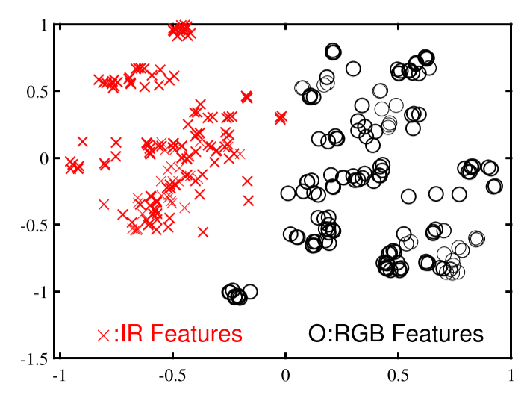
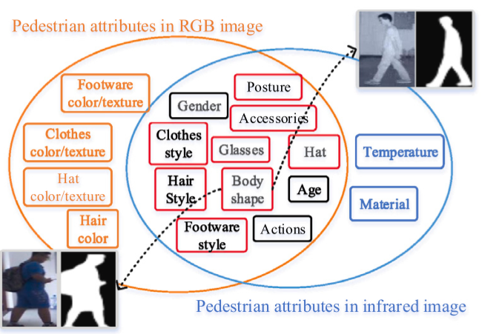
VI-ReID
Challenge: Alignment while keeping discriminated features
cross-modality variations：
1: Feature distributions of the RGB modality and the IR modality(Fig. 1)
2: Feature properties in the images of different modalities. (Fig. 2)
Fig. 1
Fig. 2
（平凡地对齐全局特征，难以利用上模态特有细粒度信息,导致模型泛化能力退化）
Notes:
（平凡地对齐全局特征，难以利用上模态特有细粒度信息,导致模型泛化能力退化） 红外和可见光的模态差异其一是，同ID不同模态特征分布差距较大，这是自然的。其二，两种模态成像原理不同，模型能从中学到的信息也不同，两者共有的主要是行人轮廓，姿态上的信息。设想一下，我们如果只是利用模型已有的ID loss和度量损失拉近图1中相同ID的两种模态的特征，那么可能的情况是模型被驱使着学到更通用，或者说两种模态共有的全局level的特征，而淡化区分度更高的局部level的特征，那这样模型的泛化能力会退化。比如同ID不同模态下行人衣服纹理这个差别是比较大的，所以我们对齐后的特征不容易体现出这一局部信息。所以如何在融合不同模态时，保留这些模态内特有，或者说不同模态间差异较大的局部信息是一个难点。

Slide 6
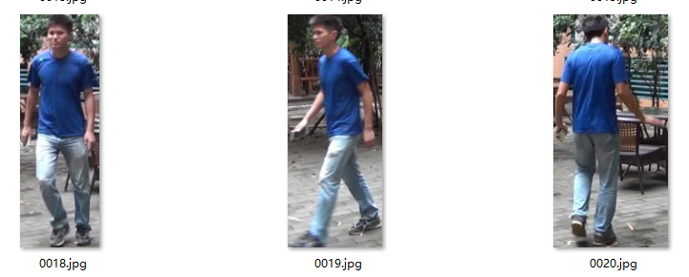
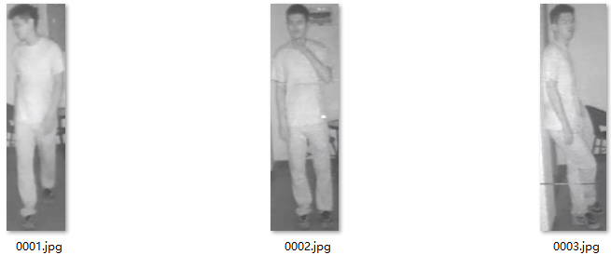
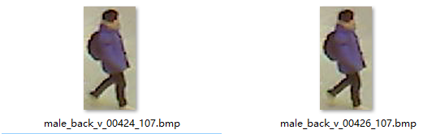
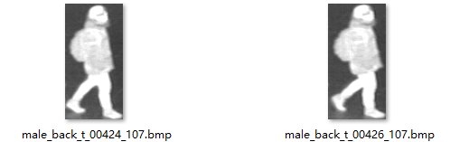
VI-ReID
Datasets: SYSU-MM01, RegDB
⬅SYSU-MM01
RegDB➡
Dataset | IDs | Cameras | Visible imgs | Infrared imgs | Total imgs | Evaluation protocol
SYSU-MM01 | 491 | 4 visible, 2 near-infrared | 30,071 | 15,792 | 45,863 | IR(query) to RGB(gallery)
RegDB | 412 | 1 visible –thermal dual mode camera | 4,120 | 4,120 | 8,240 | IR to RGB, RGB to IR
近红外摄像头（near-infrared）相比红外热成像(thermal)，直觉上成像纹理损失更小一点
Notes:
在讲跨模态问题的思路之前我们先来看看研究中常用的数据集，也就是中山大学的MM01数据集和RegDB数据集，前者是一个包含4w+张图像，491个行人的大数据集，而RegDB是一个8k+图像的小型数据集。首先两者的红外图像有些差异，SYSU中使用的是近红外摄像头，而RegDB使用的远红外热成像，简单的讲就是两者成像所用的波长不一样，远红外光和可见光差异更大，因此RegDB中红外图像纹理细节损失地更多，这点我们从样例图片就能看出来，但研究中通常不会区别对待这两个数据集。RegDB中每个行人都有10张可见光图像和10张红外图，是模态平衡的数据集，因此在RegDB的测试集上，一般都是RGB和IR相互作为query进行跨模态查询。而MM01中IR图像较少，模型评估一般就是用红外图像去匹配可见光图像。另外，RegDB的两个camera就是在同一个位置上，而MM01的场景变化和图像数更多，后者也许更能验证模型的泛化能力

Slide 7
VI-ReID
Methodology
Infrared modality
Visible modality
ID_42
ID_107
generate
project
project
generate
ID_42
ID_107
Modality-shared feature learning
Modality-specific information compensation
Notes:
在VI-Reid方向，为了克服我们之前说过的跨模态信息损失的问题，一般的方法分为两种，也就是首先在两个模态上取交集或并集，前者可以总结为模态共享的特征学习，那这种方法往往会在对齐模态之前，设计一些结构保留住模态内部，那些区分度高的特征，从而提高reid任务上的泛化能力嘛。而后者，也就是模态信息补偿的思路就是根据输入的模态生成另一种模态的图像，或者中间特征张量，然后再对齐两种模态下的特征。这种思路的难点就是加入容易受噪的生成式结构后怎么得到可靠的输出，尤其是如果要用红外生成可见光特征，红外其实本身信息量会比可见光少很多，这样的话还是比较困难的。示例图中实线框住的是原始输入的模态特征，虚线框住的是对齐后的特征

Slide 8

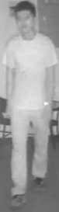
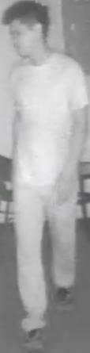

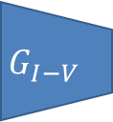
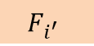
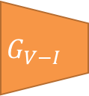

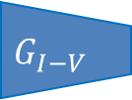
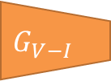

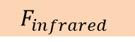

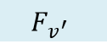
VI-ReID：Modality-specific information compensation
Methodology
Infrared modality
flow
Visible modality
flow
$$G_{V−I}$$
Fusion
$$F_{visble}$$
Image-level compensation
• AlignGAN (ICCV’19), TSME (TCSVT’22), etc.
Backbone
matching
$$G_{I−V}$$
$$F_{infrared}$$
$$G_{V−I}$$
Feature-level compensation
• cm-SSFT (CVPR’20), FMCNet (CVPR’22), etc.
$$F_{v}$$
$$F_{i^{′}}$$
Decom-pose
Backbone
matching
$$G_{I−V}$$
$$F_{i}$$
$$F_{v^{′}}$$
Notes:
接下来我们简单看一下一些已有的工作，首先是生成式的方案，像AlignGAN就是利用可见光图像生成红外图像再送到后续网络中对齐特征。当然由于可见光/红外间的模态差异较大，比较难生成高质量的图像，22年的FMCNet等工作的思路就是更端到端一点，只生成中间的特征，通常是对得到的输出解耦出两种模态下特定的特征再送后续GAN

Slide 9


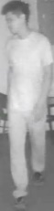
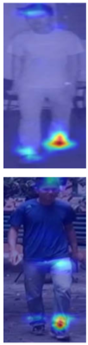
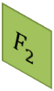











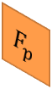
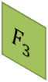
VI-ReID:Modality-shared feature learning
Infrared modality flow
Visible modality flow
Methodology
Stage 1
Stage 2
Stage 3
• • •
Stage N
Aggregate multi-level feature
• DMCF (Access’20), DEEN(CVPR’23), etc.
F
F
F
F
Alignment
F
F
F
F
F
F
F
F
F
$$F_{1}$$
$$F_{2}$$
F
F
$$F_{3}$$
$$F_{N}$$
F
2. Mining global and part information
• FBP-AL (TNNLS’21), DTRM (TIFS’22), etc.
F
F
Backbone
$$F_{p}$$
$$F$$
$$F_{p}$$
$$F$$
F
$$F_{p}$$
F
F
$$F$$
Attend
3. Employing attention mechan-ism
• CoAL (MM’ 20), MPANet (CVPR’21), DFLN-ViT (TMM’22), etc.
F
F
F
Backbone
$$F_{A}$$
$$F$$
$$F_{p}$$
$$F$$
$$F_{A}$$
F
4. Metric learning loss design, etc.
* omitted
F
F
$$F$$
Notes:
然后就是模态共享特征学习，像我们之前说的，这些方法通常要同时对齐全局和细粒度的特征，从而有效利用两个模态。比如说深层网络中浅层主要是体现底层视觉信息，而深层才是人员ID相关的信息，所以像23年的DEEN等就是融合了多level的特征。再比如说22年DTRM等工作就是把我们之前分享过的PCB的那种空间分块之类的方法应用到跨模态数据上，主要是融合行人的全局特征和部位特征。还有，我们可以引入注意力机制，这种思路的优点是模型会少一些先验，注意力权重能让模型学习到应该更关注通道上或者空间上的哪些区域，这对于提取模态共有的全局特征或局部特征都是挺有用的，今天要分享的MPANet就是主要利用了空间注意力。当然其他的思路还有不少，比如说，不从模型结构入手，而是设计度量损失函数，使得无论何种模态，输出的特征都要在不同ID间具有区分性，我们就不再细说了。

Slide 10
Contents
VI-ReID
Discover Cross-Modality Nuances for Visible-Infrared Person Re-Identification

Slide 11
1. Introduction
Discover Cross-Modality Nuances for Visible-Infrared Person Re-Identification
nuance译：细微差别
Channel-wise cross-modality discrepancy alleviation
Spatial local modality-specific feature with attention
Mutual learning style modality alignment
Notes:
接下来我们解读一下MPANet这篇工作，首先看下标题：Discover Cross-Modality Nuances for Visible-Infrared Person Re-Identification，其中nuance是指细微差别，在本文中是空间上的局部特征

Slide 12
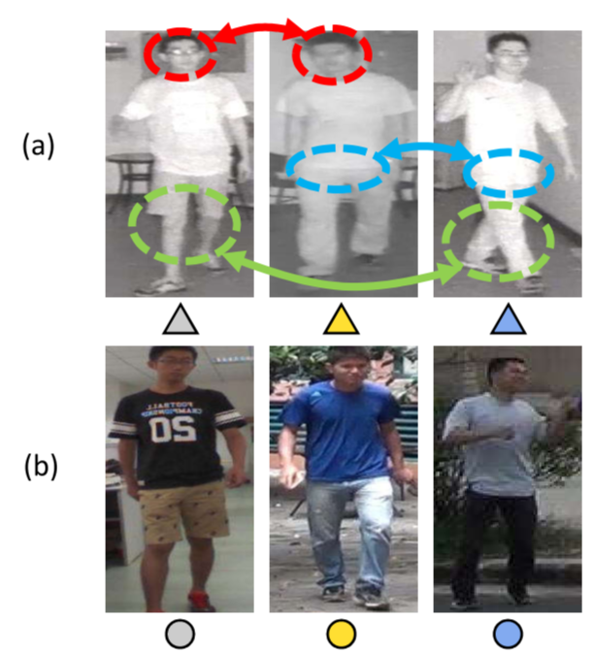
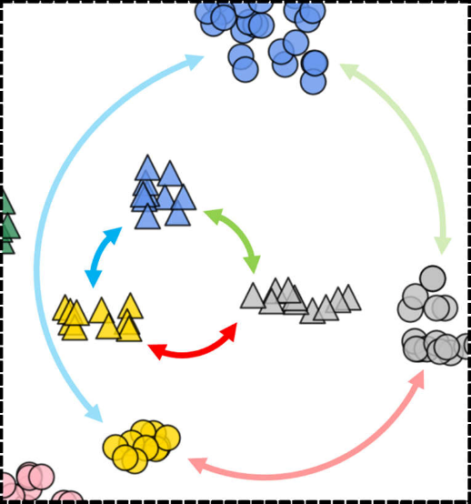
2. Motivation
Infrared modality
Visible modality
Distance
significant impact on ReID matching
Existing works mainly focus on aligning distributions of features or pixel from visible/infrared modalities.
However, nuanced but discriminative information, such as glasses, shoes,…, has not been fully explored, especially in the infrared modality.
Notes:
#TODO

Slide 13
3. Contribution
joint Modality & Pattern Alignment Network (MPANet)
We address the nuances discovery and modality discrepancy for visible-infrared person Re-ID in a unified framework. The former is not explored in the literature, while the latter is the key to matching the person across modalities.
Notes:
#TODO

Slide 14
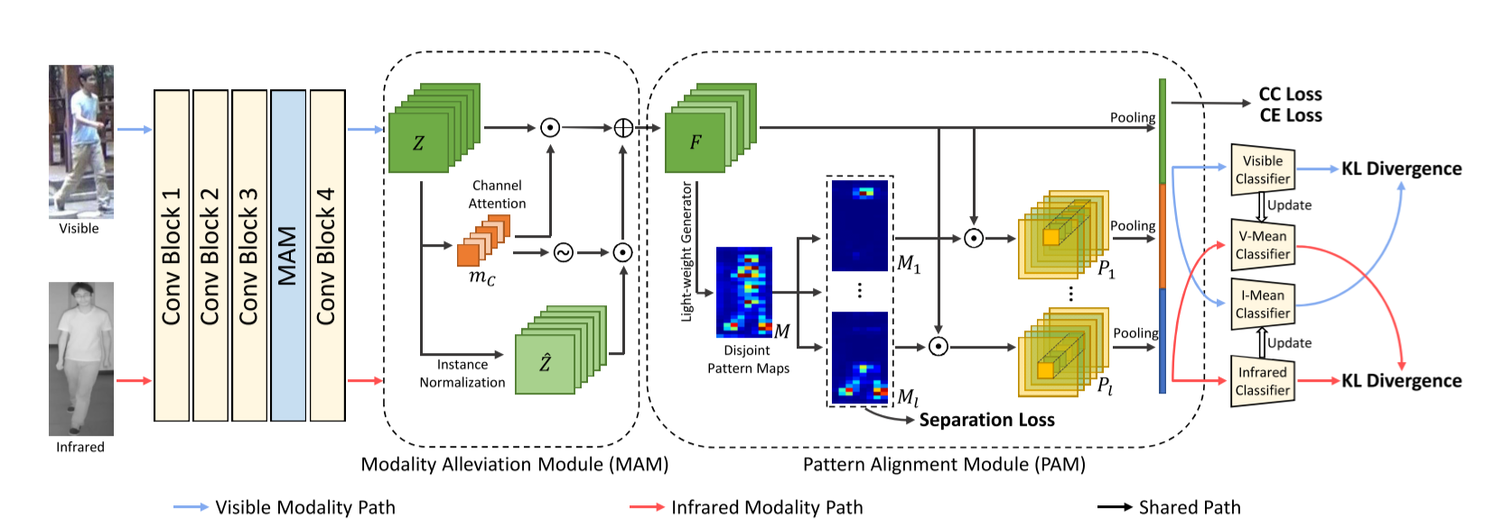
3. Contribution
joint Modality & Pattern Alignment Network (MPANet)
1. MAM(modality alleviation module):Channel-wise instance normalization
2. PAM(pattern alignment module): generates multiple spatial attention maps for the diverse patterns of a person
3. Loss: mutual learning loss for modality alignment and center cluster loss for identity learning after alignment
Notes:
#TODO

Slide 15
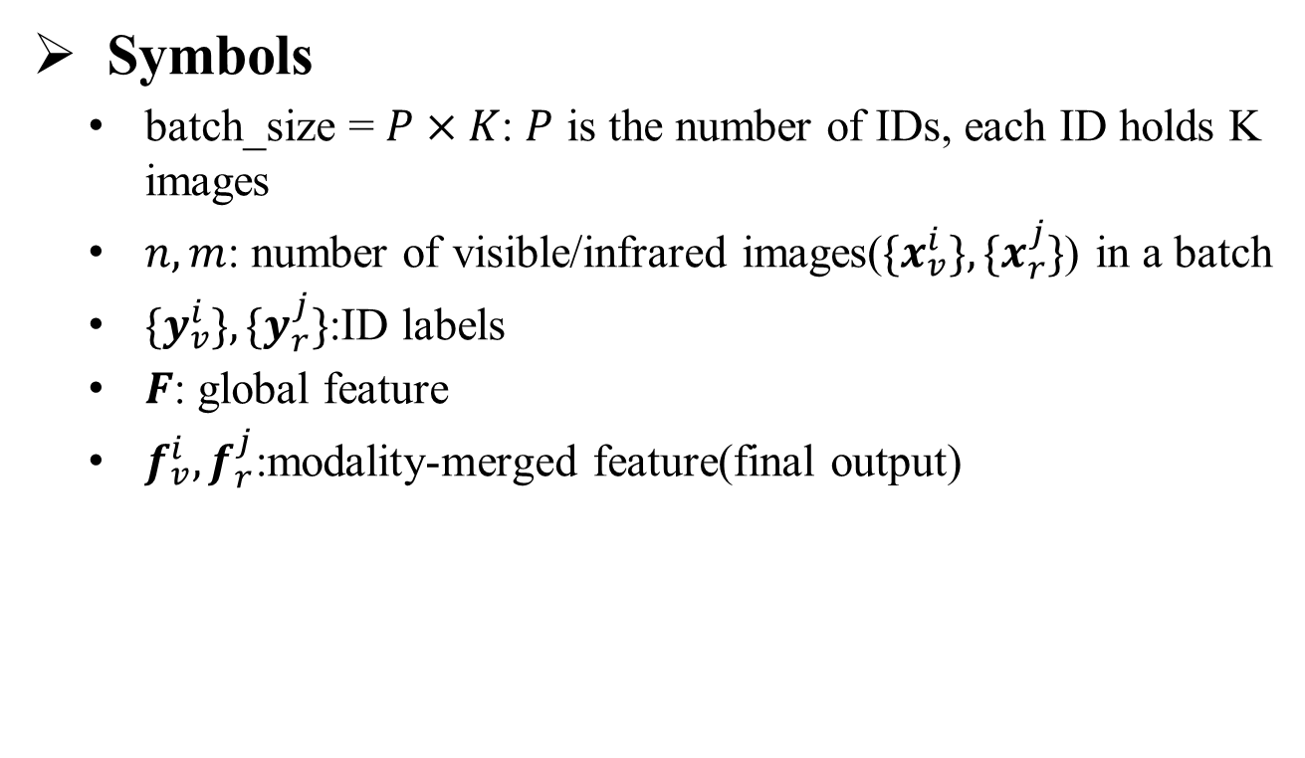
4 Method
Symbols
batch_size = $P×K$: $P$ is the number of IDs, each ID holds K images
$n, m$: number of visible/infrared images(${\{x}_{v}^{i}\}, \{x_{r}^{j}\}$) in a batch
${\{y}_{v}^{i}\},{\{y}_{r}^{j}\}$:ID labels
$F$: global feature
$f_{v}^{i}, f_{r}^{j}$:modality-merged feature(final output)
Notes:
#TODO

Slide 16
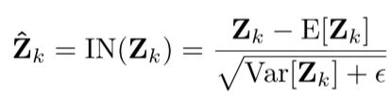
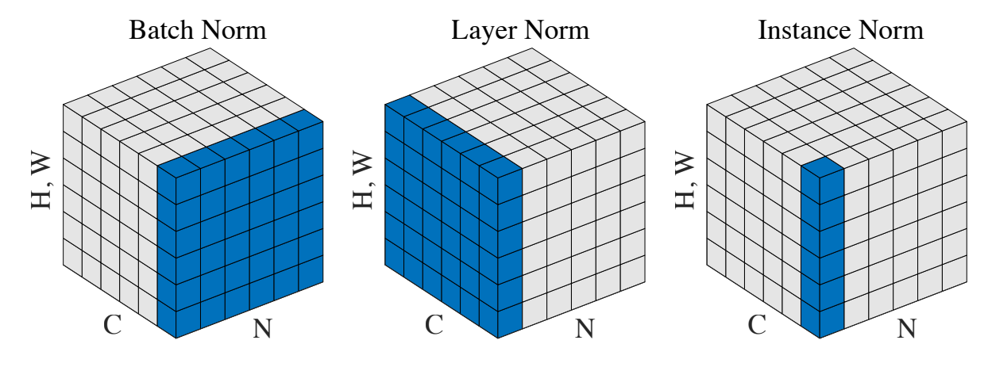
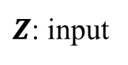
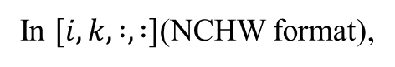
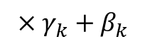
4.1 Method: MAM
Instance Normalization
$Z$: input
In $[i, k, :, :]$(NCHW format),
$$×γ_{k}+β_{k}$$
IN(by channel)
IN
IN
IN
BN
the instance normalization (IN) layer shows potential to eliminate such appearance differences … However, especially in high-level tasks … IN drops useful content information presented in the hidden features, impeding modeling capacity
(*Two at once: Enhancing learning and generalization capacities via ibn-net. ECCV’18)
Notes:
#TODO

Slide 17
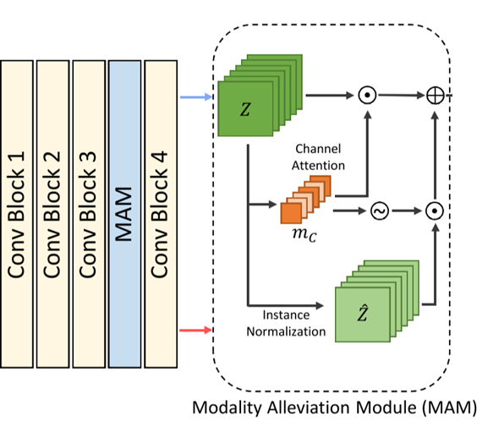
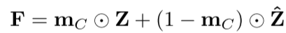
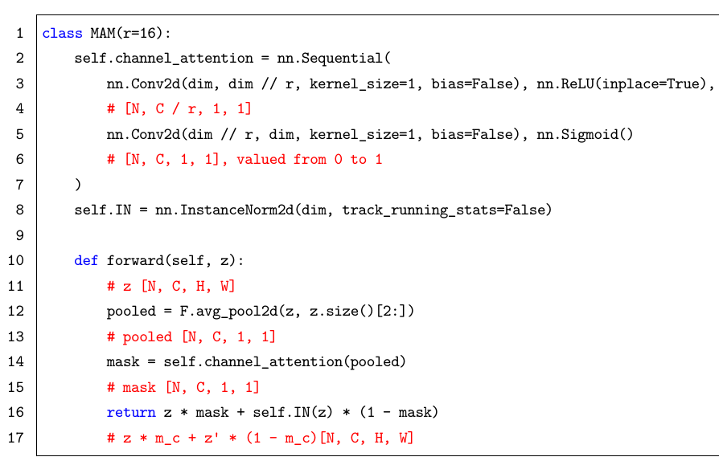
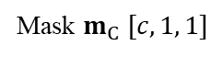
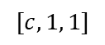
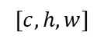

4.1 Method: MAM
SENet: Channel attention(soften the IN layers)
global pool
Conv 1*1
Conv 1*1
F
F
F
$$Z$$
$$[c, h, w]$$
$$[c, 1, 1]$$
Mask $m_{C} [c, 1, 1]$
directly applying IN may damage identify information, we apply channel attention-guided IN to alleviate modality discrepancy while preserving identity information
Notes:
#TODO

Slide 18
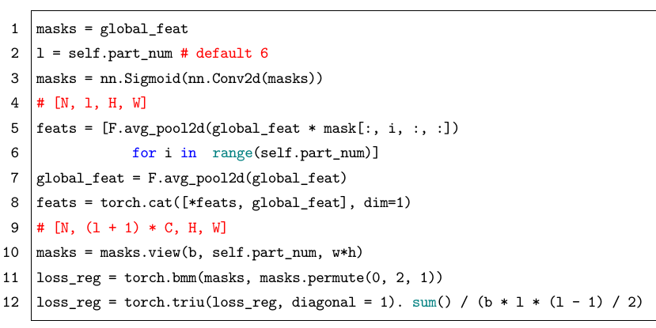
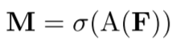
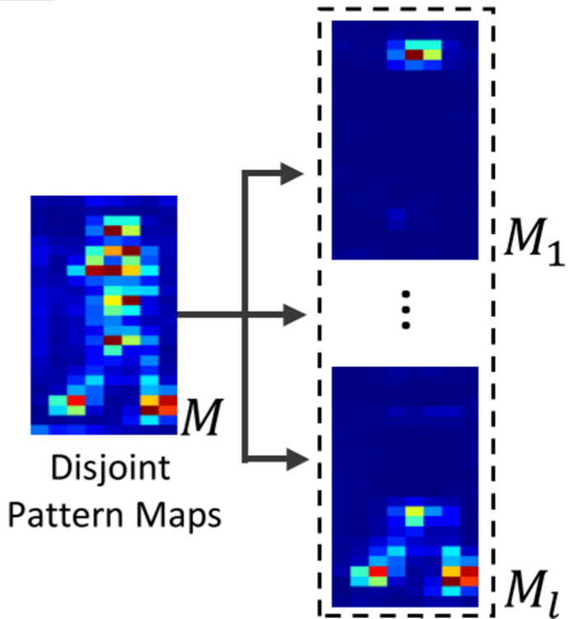
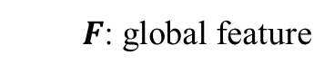
4.2 Method: PAM
Spatial Attention mechanism
$F$: global feature
PAM aims to discover the nuances in different patterns across identities, each of the pattern(spatial attention) maps should pay attention to different local information
Notes:
#TODO

Slide 19
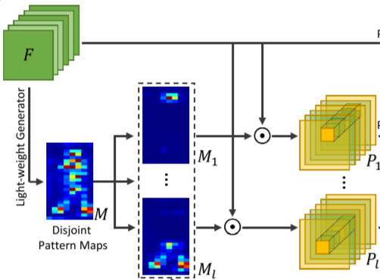
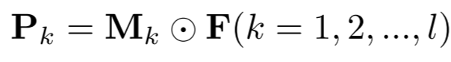
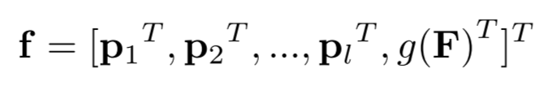
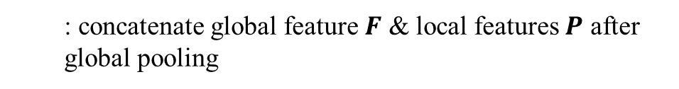
4.2 Method: PAM
Spatial Attention mechanism
$F$: global feature, ⊙ denotes attending (element-wise multiplication)
: Attend to l(=6) local features
: concatenate global feature $F$ & local features $P$ after global pooling
Notes:
#TODO

Slide 20
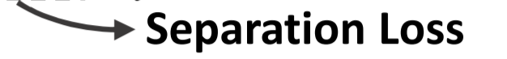
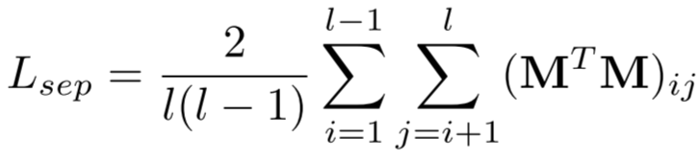
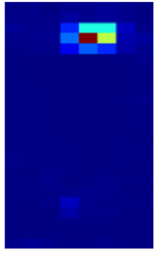






4.2 Method: PAM
Diverse patterns guiding loss
$$pattern_{i}$$
$pattern_{j}$ valued 0~1
$$= sum$$
$$sum$$
$$, i≠j$$
For Re-ID, the pattern maps should cover diverse patterns of a person so that we can identify nuances … we apply a separation loss to minimize overlapping of different spatial attention maps
Notes:
#TODO

Slide 21



4.3 Method: Mutual learning style modality alignment
KL-Divergence
Feature 1 distribution
Feature 2 distribution
KL-Divergence is a metric of how different two probability distributions(like output of a layer) are from each other.
Align features cross-modality(Modality-shared guiding loss) while keeping intra-modality nuances(Modality-specific guiding loss)
Notes:
#TODO

Slide 22


4.3 Method: Mutual learning style modality alignment
Visible modality flow
Modality-specific guiding loss
Infrared modality flow
Shared flow
As the training images fed to each classifier come from a certain modality, the classifier learns the modality-specific knowledge
Notes:
#TODO

Slide 23


4.3 Method: Mutual learning style modality alignment
Modality-shared guiding loss
Given a feature $f$, no matter which modality it comes from, if two modality-specific classifiers($C_{r}, C_{v}$) provide the same prediction, it means the modality discrepancy is eliminated.
Notes:
#TODO

Slide 24





4.3 Method: Mutual learning style modality alignment
Mean-teacher mutual learning
Momentum update : to avoid early collapse, keep a exponential moving average of $θ_{r},θ_{v}$for KL loss
A shortcut solution: $θ_{r}≡θ_{v}$
$L_{M}$ may make the predictions of the two classifiers become similar quickly
Notes:
#TODO

Slide 25

4.4 Method: Total loss
ID loss + Center cluster loss
After aligning the features of the two modalities, they are treated equally.
Notes:
#TODO

Slide 26


4.4 Method: Total loss
ID loss + Center cluster loss
A center loss and triplet loss on cluster centers of every ID
Infrared modality
ID_42
Visible modality
ID_107
cluster centers
Push away
Pull closer
$$ρ$$
ID_42
ID_107
Notes:
#TODO

Slide 27
4.4 Method: Total loss
Modality Learning
Objective losses for ReID task
Pattern Alignment Module (PAM)
Notes:
#TODO

Slide 28

5 Experiments
SYSU-MM01
Specifically, MPANet achieves the 70.58% Rank-1 acc & 68.24% mAP of in the all-search and singleshot mode, significantly improving the R-1 accuracy by 8.98% and mAP by 5.04% over the best SOTA cm-SSFT.
Github:
70.59
95.97
98.59
68.40
Notes:
#TODO

Slide 29

5 Experiments
SYSU-MM01(2023)
(CVPR’22)
(ICCV’21)
(CVPR’21)
(MM’21)
(MM’22)
(CVPR’22)
(CVPR’23)
Notes:
#TODO

Slide 30

6. Ablation Study
Importance of the Different Components
PAM(pattern alignment module) may help with improving discriminability of shared-modal feature extracted
Notes:
#TODO

Slide 31

7. Insights
Patterns attention visualization
we visualize the pixel-wise pattern maps learned by PAM(using Grad-Cam).
We can observe that every spatial attention map generated attends different pattern from the others without the effect of modality.
It demonstrates the importance
of nuances in VI-ReID, and the PAM just work well.
Notes:
#TODO

Slide 32


7. Insights
Visualization of aligned features(t-SNE)
ID_42
ID_1
ID_42
ID_37
ID_1
ID_37
ID_107
ID_107
Infrared modality
Visible modality
initial features : intra-identity modality discrepancy remains obvious and insufficient discriminable person information for ReID
Features extracted by MPANet: well grouped by identity. Improving the discriminability of features by discovering nuances.
(especially for infrared features)
Notes:
#TODO

Slide 33

7. Insights
Effect of Attention Mechanisms
mAP-diff
-0.
-4.95
-9.89
-7.85
-6.70
*NL:spatial attention, CVPR’18. SENet:channel attention, CVPR’17. CBAM:channel & spatial attention, ECCV’18
SE block cant help alleviate the modality discrepancy. While Instance Normalization can alleviate the modality discrepancy but the discriminability will be harmed at the same time.
Notes:
#TODO

Slide 34
8. Conclusion
Our method aims to both alleviate the modality discrepancy and discover the nuances in different patterns which are the keys
to solving VI-ReID task.
Notes:
#TODO

Slide 35



DEEN(CVPR’ 23)
Notes:
#TODO

Slide 36
End
Notes:
#TODO

